Slide 1
Probability and statistics 08-Introdunction to Statistics
상명대학교 휴먼지능정보공학과
2022년 2학기

Slide 2
What is a statistics (통계)?
Statistics deals with data.
Generally speaking, the goal of statistics is to make inferences based on data.
We can divide this the process into three phases: collecting data, describing data, and analyzing data.
We make hypotheses about what's true, collect data in experiments, describe the results, and then infer from the results the strength of the evidence concerning our hypotheses. → A science (or its method)

Slide 3
What is a statistic (통계량)?
Definition: A statistic is anything that can be computed from the collected data. That is, a statistic must be observable.
Example: 1000 rolls of a die.
All of the followings are statistics:
average of the 1000 rolls
the number of times a 6 was rolled
the sum of (roll)²
Not a statistic: probability of rolling a 6. ← We can estimate using the data. We cannot observe it.

Slide 4
What is a statistic (통계량)?
Point statistic: a single value computed from data, e.g. sample average X_{n} or sample standard deviation s_{n}.
Interval or range statistics: an interval [a, b] computed from the data. (Just a pair of point statistics.) Often written as X ± s.
Important: A statistic is itself a random variable since a new experiment will produce new data, and a new statistic. (It has a randomness.)

Slide 5
Question
동전이 fair하다고 믿고서 3번 던져본다.
각각의 toss의 결과를 X1, X2, X3라 한다. Xi는 Bernoulli(0.5) distribution를 따른다고 가정한다.
이 때 statistic인 것은?
(a) sample average X = (X1+X2+X3)/3.
(b) Expected value of X = E(X) = 1.5
(c) X와 E(X)의 차이

Slide 6
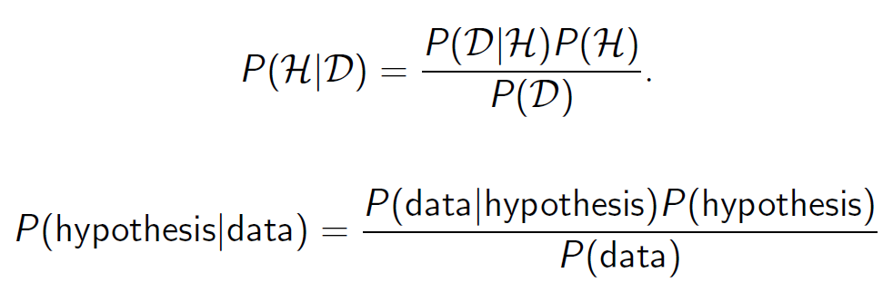
Bayes’ theorem
Bayes’ theorem is the key to our view of statistics.
We want to know with given data, probability that the hypothesis is true. (RHS)

Slide 7
Example
A disease test has the false positive rate 1%; the false negative rate 1%.
The population disease rate 0.2%.
A person tests positive.
Hypothesis: H = ‘the person has the disease’
Data: D = ‘the test was positive’
We want to know: P(H|D)
P(H|D) = P(D|H)P(H)/P(D)
P(D|H) = 1 – P(D^{c}|H) = 1 – False negative rate = 0.99
P(H) = the population disease rate = 0.002
P(D) = P(D|H^{c})P(H^{c}) + P(D|H)P(H) = 0.01*0.998 + 0.99*0.002 = 0.01196
P(H|D) = 0.166.
Before test: 0.002 → After test: 0.166

